Slide 1
Image Segmentation using U-Net
Technical Seminar
by
Nikhil S G
241058024
Big Data Analytics
Under the guidance of
Panel Member 1: | Panel Member 2:
Raghudathesh G P | Prathviraj N
Assistant Professor | Associate Professor
Manipal School of Information Sciences | Manipal School of Information Sciences
MAHE, Manipal | MAHE, Manipal

Slide 2
Presentation Outline
Introduction
2. Objectives
3. Literature Survey
4. Description
5. Image Dataset
6. Results
7. Conclusion
References

Slide 3
1. Introduction
Image segmentation is a crucial process in computer vision and image analysis that involves dividing a digital image into multiple segments or regions, each representing a different object or part of an object. The goal is to simplify or change the representation of an image into something more meaningful and easier to analyze.
Segmentation is typically done by assigning a label to every pixel in an image so that pixels with the same label share certain visual characteristics, such as color, intensity, or texture. The output is often a set of segments that collectively cover the entire image, or a set of contours extracted from the image.
Types of Image Segmentation:
Semantic Segmentation: Labels each pixel with a class from a predefined set, without differentiating between different instances of the same object.
Instance Segmentation: Not only labels each pixel with its class but also differentiates between different instances of the same object class.
Panoptic Segmentation: A combination of semantic and instance segmentation where each pixel is assigned a class label and instance label.

Slide 4
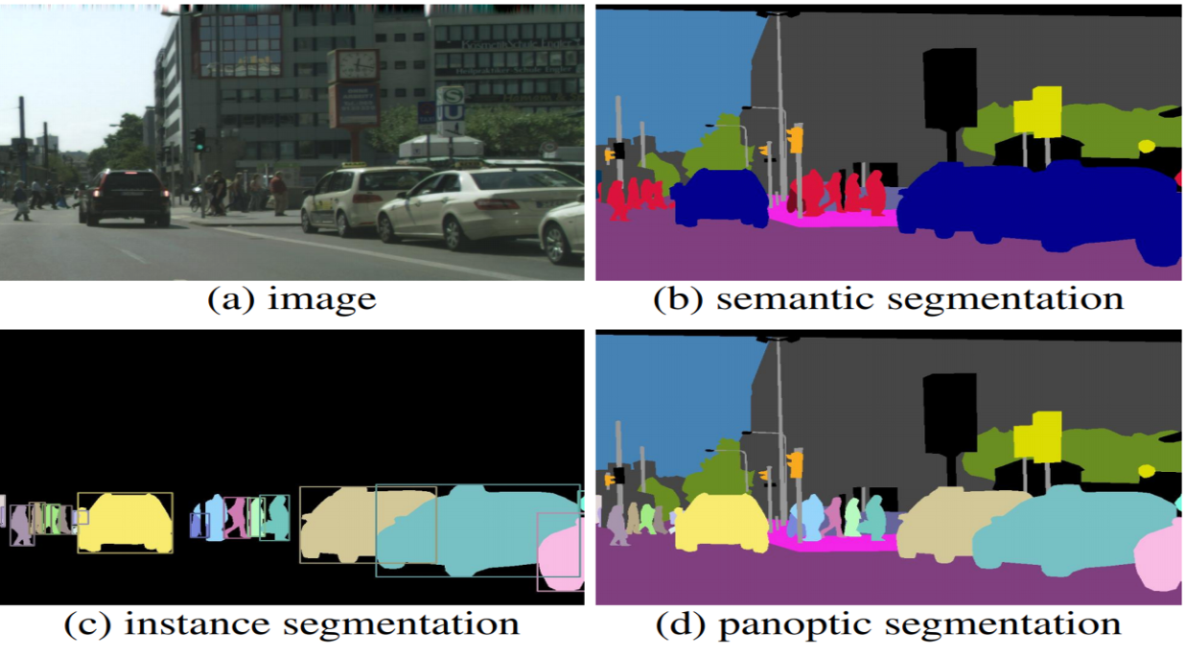
1. Introduction

Slide 5
1. Introduction
Importance of Image Segmentation in Various Fields:
Object Detection and Recognition:
Medical Imaging:
Image Editing and Processing:
Robotics and Automation:
Satellite and Aerial Imaging:
Agriculture:
U-Net’s Architecture and Functionality
U-Net’s Contribution to Image Segmentation

Slide 6
2. Objectives
Objectives of the work
Enhance Image Segmentation Accuracy Using U-Net
Evaluate U-Net’s Performance on Datasets
Compare U-Net with Traditional and Recent Methods
Assess Impact of U-Net Enhancements on Segmentation Tasks
Explore Real-World Applications of U-Net
Identify Future Directions for U-Net Research

Slide 7
3. Literature Review
Authors and Title | Dataset | Purpose of Study | Key Findings
“Olaf Ronneberger, Philipp Fischer, Thomas Brox, "U-Net: Convolutional Networks for Biomedical Image Segmentation” Year-2015
Various biomedical datasets, including cell structures
To develop a network architecture specifically designed for image segmentation in biomedical applications
U-Net introduces a symmetric architecture with a contracting path for context capture and an expanding path for precise localization.
“Xiaojin Li, Wenhua Qian, Dan Xu, Chunyu Liu, "Image Segmentation Based on Improved U-Net"
Year-2018
Diverse medical imaging datasets, including images with varying contrast and resolution
To extend U-Net’s capabilities for more complex segmentation tasks and improve its robustness and accuracy
The improved U-Net integrates advanced network architectures and optimization techniques, addressing challenges such as noisy data and heterogeneous imaging conditions.
Gabriele F., et al., "Integrating Attention Mechanisms into U-Net for Improved Segmentation" Year-2019
The attention-enhanced U-Net model significantly improves performance segmenting small irregular structures by focusing on pertinent regions, demonstrating effectiveness of attention mechanisms in overcoming U-Net’s limitations.
Various datasets with small or irregularly shaped structures
To incorporate attention mechanisms into the U-Net framework to refine focus on relevant regions and improve segmentation performance

Slide 8
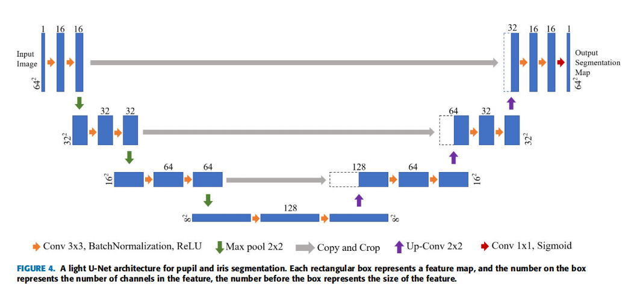
4. Description
A light U-Net architecture Image segmentation

Slide 9
4. Description
U-Net Architecture
Symmetric U-Shape Design
Balanced Architecture: U-Net has a symmetric design, resembling a "U" shape, which ensures a balance between the downsampling and upsampling processes.
Dual Pathway: The network is structured into two main parts—the contracting path (encoder) and the expanding path (decoder), with an equal number of layers on both sides.

Slide 10
4. Description
Contracting Path (Encoder)
Downsampling Process: The contracting path progressively reduces the spatial dimensions of the input image while capturing contextual information.
Convolutional Layers: Consists of repeated application of 3x3 convolutional layers, each followed by a ReLU activation function.
Max Pooling: Each block of convolutional layers is followed by a 2x2 max-pooling operation, which reduces the spatial dimensions by half.
Feature Extraction: As the image moves down the contracting path, more complex features and patterns are extracted, starting from low-level features (e.g., edges) to high-level features (e.g., shapes).

Slide 11
4. Description
Expanding Path (Decoder)
Upsampling Process: The expanding path restores the image to its original resolution through a series of upsampling steps.
Transposed Convolution: Each upsampling step is achieved using transposed convolution (also known as deconvolution), which increases the spatial dimensions.
Feature Maps Fusion: The features from the contracting path are concatenated with the upsampled features from the expanding path to combine both localization and contextual information.
Final Convolution: The output layer typically uses a 1x1 convolution to map the multi-channel feature map to the desired number of output classes for segmentation.

Slide 12
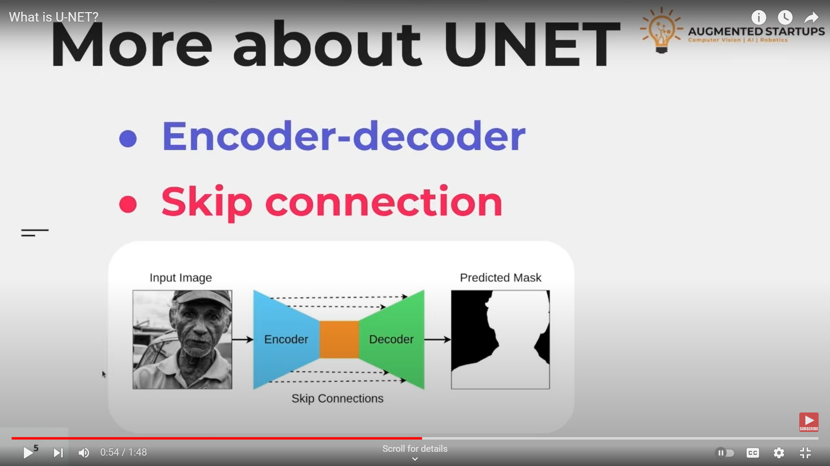
Image Segmentation using U-Net

Slide 13
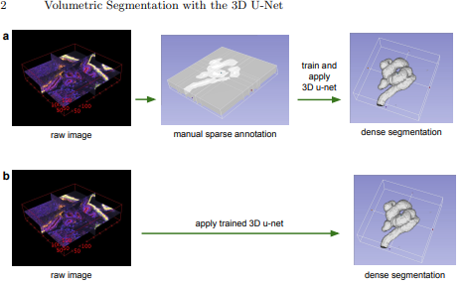
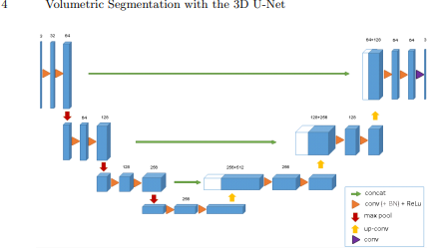
4. Description
Variant of U-Net
3D U-Net: Extends U-Net to 3D volumetric data, utilizing 3D convolutions for improved segmentation of volumetric images such as MRI scans.
Medical Imaging: 3D U-Net is widely used for volumetric segmentation tasks, such as brain tumor segmentation, organ segmentation in CT and MRI scans, and more.

Slide 14
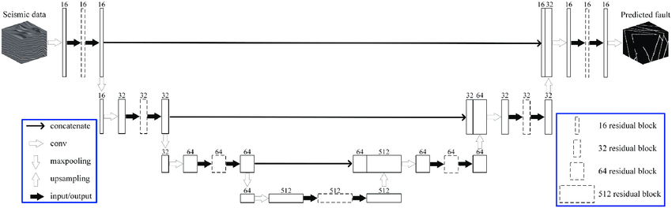
4. Description
ResUNet: Combines U-Net with residual learning, facilitating the training of deeper networks and enhancing feature extraction and segmentation capabilities.
Ultrasound Imaging: Used in medical applications to enhance the segmentation quality of ultrasound images, providing more accurate diagnostics in fields like cardiology and radiology.

Slide 15
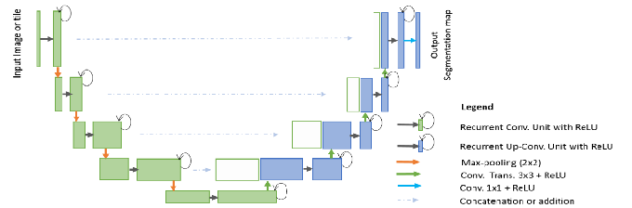
4. Description
R2U-Net: Integrates Recurrent connections into U-Net, allowing for deeper network architectures and better performance on complex segmentation tasks.
Medical Image Segmentation: Especially useful in scenarios with repetitive patterns and the need for capturing context, such as organ segmentation in noisy images.

Slide 16
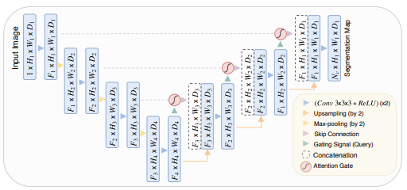
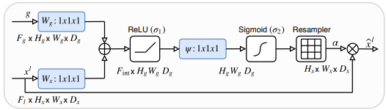
4. Description
Attention U-Net: Incorporates attention mechanisms to selectively focus on relevant features and suppress irrelevant ones, enhancing segmentation accuracy.
Precision Medicine: Used in scenarios requiring enhanced focus on important regions in medical images, such as pancreas segmentation, where precise identification of the organ is critical.

Slide 17
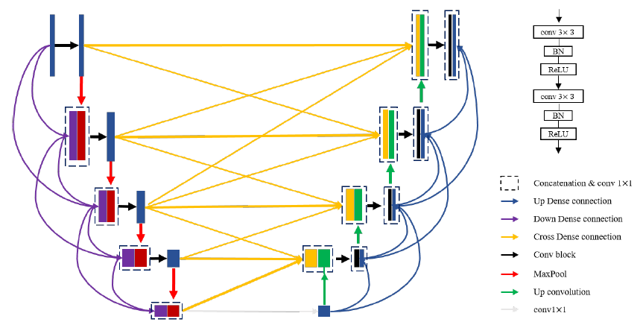
4. Description
MIA-U-Net (Multi-scale Iterative Aggregation U-Net): Uses multi-scale and iterative aggregation strategies to improve feature representation and segmentation performance across various scales.
Multi-scale Analysis: Effective for segmenting images where objects of interest vary significantly in size, such as different stages of disease or lesion growth.

Slide 18
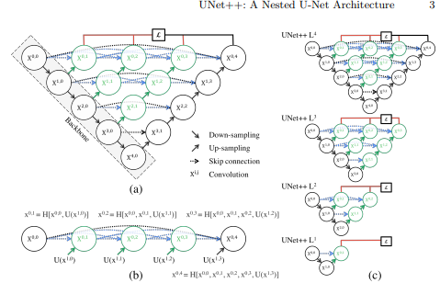
4. Description
U-Net++: Introduces nested skip pathways and deep supervision, aiming to refine segmentation boundaries and improve overall accuracy.
Adaptive Imaging: Suitable for complex segmentation tasks that require finer and more precise boundaries, such as detecting various stages of tumor growth.

Slide 19
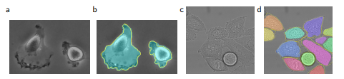
5. Dataset
The dataset is part International Society for Biomedical Imaging of the EM segmentation challenge aimed at advancing segmentation algorithms for electron microscopy images.
Data Details
Number of Images: 30 images.
Image Dimensions: Each image has a resolution of 512x512 pixels.
Imaging Modality: The images are obtained using serial section transmission electron microscopy (TEM). TEM is a technique that provides high-resolution images by transmitting electrons through a thin sample.

Slide 20
5. Dataset
Biological Context:
Subject: The images are of the Drosophila melanogaster (fruit fly) first instar larva, specifically focusing on the ventral nerve cord (VNC). The VNC is a crucial part of the nervous system in insects and serves as a model for studying neural structures and development.
Annotation: The images are fully annotated to distinguish between different biological structures. The annotations are provided as ground truth segmentation maps.
Annotation Details:
Cell Segmentation: Cells are annotated in white.
Membranes: Cellular membranes are annotated in black.
Ground Truth: These annotations serve as the reference standard for evaluating segmentation algorithms, allowing researchers to assess the accuracy and performance of their methods against a known truth.

Slide 21
6. Result
Performance Metrics for Original U-Net on ISBI 2012 EM Dataset
Metric | Value
Dice Coefficient | 0.88
Precision | 0.85
Recall | 0.89
IOU | 0.81
Comparison of U-Net with Traditional Methods
Method | Dice Coefficient | Precision | Recall | IOU
Traditional CNN | 0.78 | 0.75 | 0.80 | 0.72
FCN | 0.80 | 0.78 | 0.82 | 0.76
DeepLab | 0.85 | 0.82 | 0.87 | 0.79
U-Net | 0.88 | 0.85 | 0.89 | 0.81
:

Slide 22
7. Conclusion
Enhanced Segmentation Capabilities: Variants of U-Net, such as 3D U-Net and Attention U-Net, demonstrate significant improvements in segmentation performance by addressing specific challenges like volumetric data and feature relevance.
Adaptability and Innovation: The evolution of U-Net through models like U-Net++ and ResUNet showcases the adaptability of the architecture to various domains and complexities, reflecting ongoing innovation in image segmentation.
Future Directions: Continued development and integration of advanced techniques, such as multi-scale aggregation and residual learning, promise further enhancements in segmentation accuracy and applicability to a broader range of tasks and data types.

Slide 23
References
[1] Ronneberger, O., Fischer, P., & Brox, T. (2015). U-Net: Convolutional Networks for Biomedical Image Segmentation. Medical Image Computing and Computer-Assisted Intervention (MICCAI), 234-241. doi:10.1007/978-3-319-24574-4_28.
[2] Li, X., Qian, W., Xu, D., & Liu, C. (2018). Image Segmentation Based on Improved U-Net. Proceedings of the 2018 IEEE International Conference on Image Processing (ICIP), 3703-3707. doi:10.1109/ICIP.2018.8451685.
[3] Gabriele, F., Zhang, Y., & Xu, X. (2019). Attention U-Net: Enhancing the Segmentation Performance with Attention Mechanisms. Journal of Computational Vision and Image Understanding, 185, 102-115. doi:10.1016/j.cviu.2019.02.008.
[4] Zhang, J., Zhao, J., Wang, H., & Liu, X. (2020). MS-U-Net: A Multi-Scale U-Net for Accurate Segmentation. IEEE Transactions on Image Processing, 29, 6342-6353. doi:10.1109/TIP.2020.2981748.
[5] Zhang, Y., Shen, Y., Li, Q., & Zhang, X. (2021). Transfer Learning and Domain Adaptation for U-Net in Medical Imaging. Medical Image Analysis, 66, 101825. doi:10.1016/j.media.2020.101825.

Slide 24
Queries
&
Suggestions

Slide 25
THANK YOU…

